Slide 1
DATA MINING & MACHINE LEARNING: Machine Learning
Fosca Giannotti
Revisited slides from Lecture Notes for Chapter 7 “Introduction to Data Mining”, 2nd Edition by Tan, Steinbach, Karpatne, Kumar
Revisited slides from Lecture Notes for Chapter 19 “AI : a modern approach”, 4th Edition by Stuart Russell and Narvig
Slides Prepared by Said Kerrache,

Slide 2
Supervised Learning
Supervised learning refers to problems where the value of a target attribute should be predicted based on the values of other attributes.
Problems with a categorical target attribute are called classification, problems with a numerical target attribute are called regression.
Attributes/Features
Target Variable

Slide 3
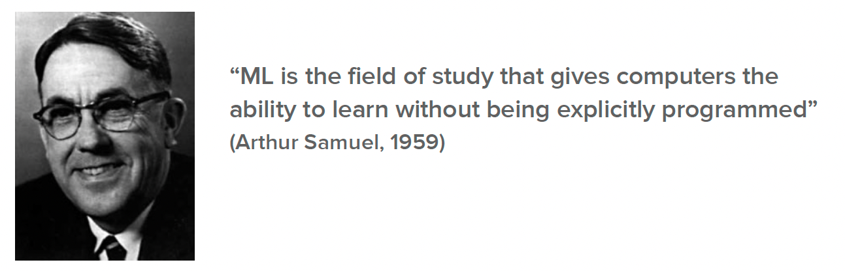
What is Machine Learning?
Machine Learning (ML) is the science (and art) of programming computers that can learn from data.

Slide 4
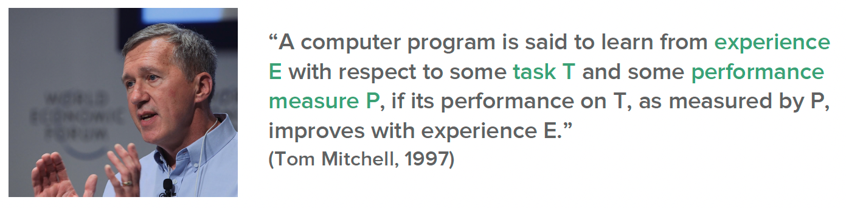
What is Machine Learning?
Machine Learning (ML) is the science (and art) of programming computers that can learn from data.

Slide 5
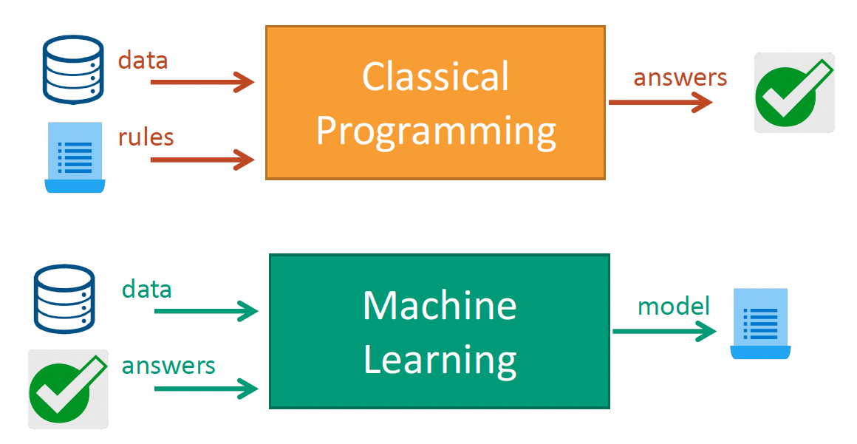
Classical Programming vs Machine Learning
A ML system is trained rather than programmed

Slide 6
Classical Programming vs Machine Learning
A ML system is trained rather than programmed

Slide 7
Classical Programming vs Machine Learning
A ML system is trained rather than programmed

Slide 8
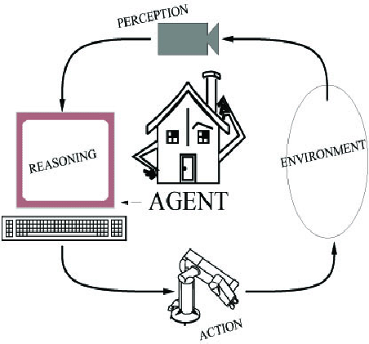
Components of a classical AI System
An agent perceives its environment
through sensors and acts on the
environment through actuators.
Human: sensors are eyes, ears,
actuators (effectors) are hands,
legs, mouth.
Robot: sensors are cameras, sonar,
lasers, ladar, bump, effectors are
grippers, manipulators, motors
The agent’s behavior is described by its
function that maps percept to action.
Notes:
LADAR is Laser Detection and Ranging
Light radar by uses light

Slide 9
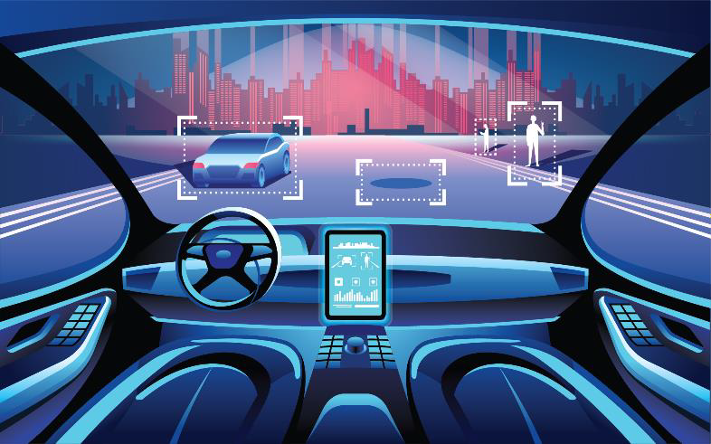

Components of the agent that may be improved by learning
Learning from a driver.
The traffic light is red: brake!
Recognizing buses and pedestrians from images
If you brake hardly on a wet road,
you are in danger
Passengers complaint about driving
1. Mapping from conditions to actions
2. Inferation properties of the
world from perceptions
Example
3. Information about the world’s evolution
4. Overall utility and goals

Slide 10
Boundary Factors of Learning
Any component of an agent program can be improved by machine learning upon these factors:
Component to be improved
Prior knowledge
Data and feedbacks

Slide 11

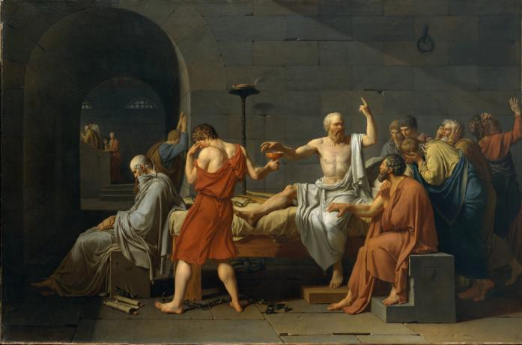
Forms of learning
INDUCTION
From the specific to a general rule
Example
The sun rose every days in the past
The sun will rise tomorrow
Not always true
DEDUCTION
From a general rule to the specific
Example
Every human is mortal. Socrate is a human
Socrate is mortal
Always true

Slide 12


Types of input and output
Factored representation for input
The input is a vector of attribute values (FEATURES)
Output
Classification: the output is one from a finite set (LABEL)
Regression: the output is a number

Slide 13
Types of learning based on feedback
Supervised learning: the agent
learns from input-output pairs
Unsupervised learning: the agent learns patterns without explicit feedback
Reinforcement learning: the agent learns thanks to rewards and punishments
Images as inputs ՜ “bus” or
“pedestrians” as output (labels) – classification
Speed and direction of a car as input ՜ distance to stop as output - regression
Clustering: recognizing cats from millions of images
The chess game is won ՜ reward The chess game is lost ՜ punishment

Slide 14
Supervised Learning
TASK: Given a training set 𝑥₁, 𝑦₁ , 𝑥₂, 𝑦₂ , … , (𝑥_{𝑁}, 𝑦_{𝑁}) of an unknown function 𝑦 = 𝑓(𝑥),
discover a function ℎ that approximates 𝑓
ℎ ∈ 𝐻
𝑦_{𝑖}
Ground truth
Hypothesis
Model
Function
Hypotesis space
Model class
Function class
How do we choose 𝐻?
Exploratory data anlysis: examining data with statistical tests
Multiple try of hypothesis spaces How do we choose a good ℎ within 𝐻?
Consistent ipothesis if ℎ 𝑥_{𝑖} = 𝑦_{𝑖}
Best-fit function if ℎ(𝑥_{𝑖}) is close 𝑦_{𝑖}
Test set
ℎ generalizes well if it accurately predicts the output of a test set

Slide 15
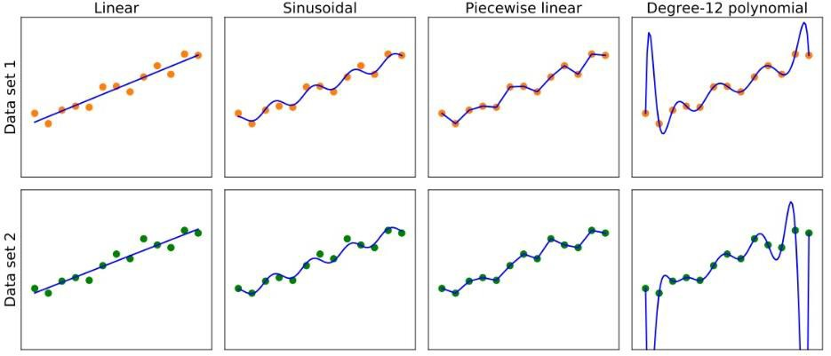
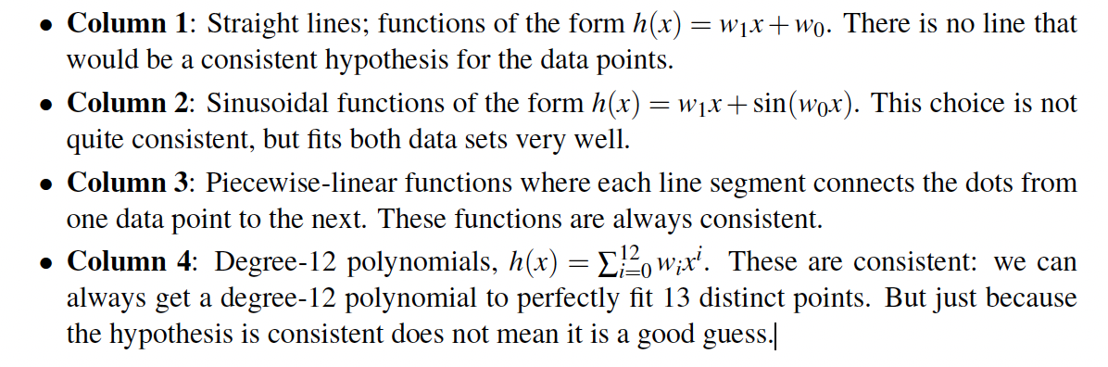
How to choose a good H and h

Slide 16
How to compare hypothesis spaces
Evaluation of:
Bias
tendency of ℎ to deviate from the expected value
Variance
Tradeoff
Bias and variance should be low
The amount of change in ℎ due to variation of training data
In 𝐻 the most probable ℎ is
ℎ∗ = argmax 𝑃 ℎ 𝑑𝑎𝑡𝑎 =
ℎ∈𝐻
𝐵𝑎𝑦𝑒𝑠
= argmax 𝑃 𝑑𝑎𝑡𝑎 ℎ 𝑃(ℎ)
ℎ∈𝐻
Where 𝑃(ℎ) is the prior
probability
Variance
Bias

Slide 17

Classification

Slide 18
Example: Spam Filter
Input: an email
Output: spam/ham (Ham messages are the intended or safe legitimate messages in a mailbox; whereas Spam messages are the junk, unsolicited bulk or commercial messages in the mailbox)
Setup:
Get a large collection of example emails, each labeled “spam” or “ham”
Note: someone has to hand label all this data!
Want to learn to predict labels of new, future emails
Features: The attributes used to make the ham / spam decision
Words: FREE!
Text Patterns: $dd, CAPS
Non-text: SenderInContacts, WidelyBroadcast
…
Dear Sir.
First, I must solicit your confidence in this transaction, this is by virture of its nature as being utterly confidencial and top secret. …
TO BE REMOVED FROM FUTURE MAILINGS, SIMPLY REPLY TO THIS MESSAGE AND PUT "REMOVE" IN THE SUBJECT.
99 MILLION EMAIL ADDRESSES
FOR ONLY $99
Ok, Iknow this is blatantly OT but I'm beginning to go insane. Had an old Dell Dimension XPS sitting in the corner and decided to put it to use, I know it was working pre being stuck in the corner, but when I plugged it in, hit the power nothing happened.

Slide 19




Example: Digit Recognition
Input: images / pixel grids
Output: a digit 0-9
Setup:
Get a large collection of example images, each labeled with a digit
Note: someone has to hand label all this data!
Want to learn to predict labels of new, future digit images
Features: The attributes used to make the digit decision
Pixels: (6,8)=ON
Shape Patterns: NumComponents, AspectRatio, NumLoops
…
Features are increasingly induced rather than crafted
0
1
2
1
??

Slide 20
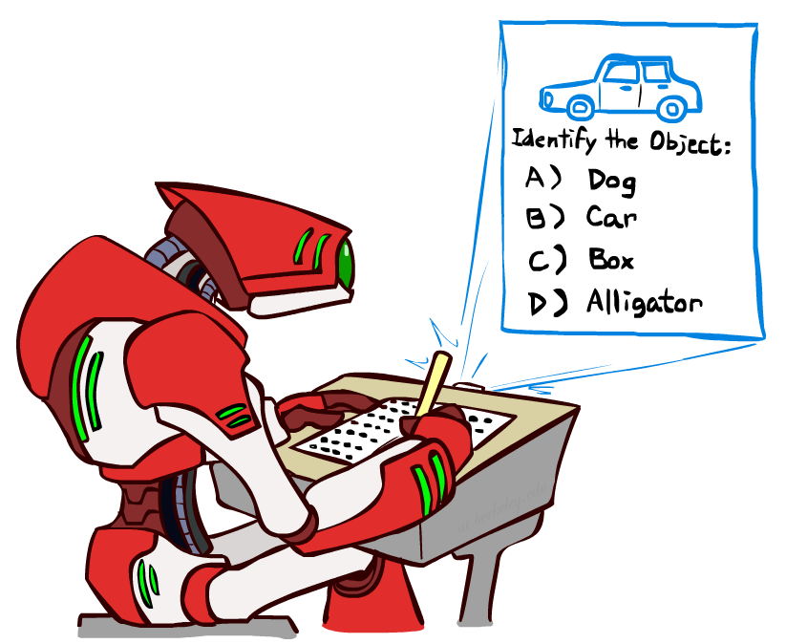
Other Classification Tasks
Classification: given inputs x, predict labels (classes) y
Examples:
Medical diagnosis (input: symptoms,
classes: diseases)
Fraud detection (input: account activity,
classes: fraud / no fraud)
Automatic essay grading (input: document,
classes: grades)
Customer service email routing
Review sentiment
Language ID
… many more
Classification is an important commercial technology!

Slide 21
Examples of Classification Task
Task | Attribute set, x | Class label, y
Categorizing email messages | Features extracted from email message header and content | spam or non-spam
Identifying tumor cells | Features extracted from MRI scans | malignant or benign cells
Cataloging galaxies | Features extracted from telescope images | Elliptical, spiral, or irregular-shaped galaxies

Slide 22
What is Classification?
Classification consists in learning a model/function f that maps each attribute set x into one of the predefined class labels y: f(x) = y
The learning is performed on a given a collection of records named training set where each record is characterized by a tuple (x, y), where x is the attribute set and y is the class label
x: attribute, predictor, independent variable, input
y: class, response, dependent variable, output
Goal: previously unseen records should be assigned a class as accurately as possible. A test set is used to determine the accuracy of the model f.
Usually, the given data set is divided into training and test sets, with training set used to build the model and test set used to validate it.

Slide 23

Classification problem
What we have
A set of objects, each of them described by some features
people described by age, gender, height, etc.
bank transactions described by type, amount, time, etc.
What we want to do
Associate the objects of a set to a class, taken from a predefined list
“good customer” vs. “churner”
“normal transaction” vs. “fraudulent”
“low risk patient” vs. “risky”
?
Feature 2
(e.g. Income)
?
?
35k€
?
?
15k€
Feature 1
(e.g. Age)
50y
60y

Slide 24


Classification problem
What we know
No domain knowledge or theory
Only examples: Training Set
Subset of labelled objects
What we can do
Learn from examples
Make inferences about the other objects

Slide 25
The most stupid classifier
Rote learner
To classify object X, check if there is a labelled example in the training set identical to X
Yes → X has the same label
No → I don’t know
?

Slide 26
Classify by similarity
K-Nearest Neighbors
Decide label based on K most similar examples
K=3

Slide 27
Build a model
Example 1: linear separation line

Slide 28
Build a model
Example 2: Support Vector Machine (linear)

Slide 29
Build a model
Example 3: Non-linear separation line

Slide 30
Build a model
Decision Trees
Income > 15k€ ?
Income
yes
no
Age > 50y ?
yes
no
Age

Slide 31
From toys to real problems
Many issues in practice
Non-separable classes → trade-offs
Unbalanced classes: 100 s against 100k s
Most methods would treat all as noise
Scalability: from 10 objects to millions
Dimensionality: from 2 features to hundreds
The curse of dimensionality: distances become meaningless
…

Slide 32
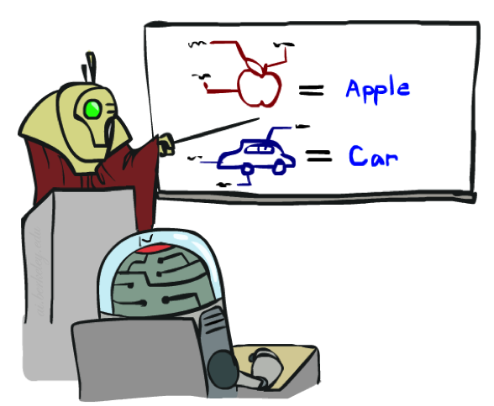


Training and Testing

Slide 33
Empirical Risk Minimization
Empirical risk minimization
Basic principle of machine learning
We want the model (classifier, etc) that does best on the true test distribution
Don’t know the true distribution so pick the best model on our actual training set
Finding “the best” model on the training set is phrased as an optimization problem
Potential worry: overfitting to the training set
Better with more training data (less sampling variance, training more like test)
Better if we limit the complexity of our hypotheses (regularization and/or small hypothesis spaces)

Slide 34
General Approach for Building Classification Model

Slide 35
General Approach for Building Classification M
Training Set
model fit
Classifier
Dataset
X_{train}
Model
Learning
f
X
Y_{train}
Y
X_{test}
Model
Application
model
predict
Y_{test}
Test Set
Model
Evaluation
Accuracy
Y_{pred}
Prediction

Slide 36



Important Concepts
Data: labeled instances (e.g. emails marked spam/ham)
Training set
Held out set
Test set
Features: attribute-value pairs which characterize each x
Experimentation cycle
Learn parameters (e.g. model probabilities) on training set
(Tune hyperparameters on held-out set)
Compute accuracy of test set
Very important: never “peek” at the test set!
Evaluation (many metrics possible, e.g. accuracy)
Accuracy: fraction of instances predicted correctly
Overfitting and generalization
Want a classifier which does well on test data
Overfitting: fitting the training data very closely, but not generalizing well
Training
Data
Held-Out
Data
Test
Data

Slide 37
Classification Techniques
Base Classifiers
Decision Tree based Methods
Rule-based Methods
Nearest-neighbor
Neural Networks
Deep Learning
Naïve Bayes and Bayesian Belief Networks
Support Vector Machines
Ensemble Classifiers
Boosting, Bagging, Random Forests

Slide 38
Decision Tree

Slide 39
Example of a Decision Tree
Consider the problem of predicting whether a loan borrower will repay the loan or default on the loan payments.
categorical
categorical
continuous
class
Splitting Attributes
Home Owner
Yes
No
NO
MarSt
Single, Divorced
Married
Income
NO
< 80K
> 80K
NO
YES
Training Data
Model: Decision Tree

Slide 40
Another Example of Decision Tree
categorical
categorical
continuous
class
Single, Divorced
MarSt
Married
NO
Home Owner
Yes
No
NO
Income
< 80K
> 80K
NO
YES
There could be more than one tree that fits the same data!

Slide 41
Apply Model to Test Data
Test Data
Start from the root of tree.
Home Owner
Yes
No
NO
MarSt
Single, Divorced
Married
Income
NO
< 80K
> 80K
NO
YES

Slide 42
Apply Model to Test Data
Test Data
Home Owner
Yes
No
NO
MarSt
Single, Divorced
Married
Income
NO
< 80K
> 80K
NO
YES

Slide 43
Apply Model to Test Data
Test Data
Home Owner
Yes
No
NO
MarSt
Single, Divorced
Married
Income
NO
< 80K
> 80K
NO
YES

Slide 44
Apply Model to Test Data
Test Data
Home Owner
Yes
No
NO
MarSt
Single, Divorced
Married
Income
NO
< 80K
> 80K
NO
YES

Slide 45
Apply Model to Test Data
Test Data
Home Owner
Yes
No
NO
MarSt
Single, Divorced
Married
Income
NO
< 80K
> 80K
NO
YES

Slide 46
Apply Model to Test Data
Test Data
Home Owner
Yes
No
NO
MarSt
Single, Divorced
Married
Assign Defaulted to “No”
Income
NO
< 80K
> 80K
NO
YES

Slide 47
Decision Tree Classification Task
Decision Tree

Slide 48
Decision Tree Induction
Many Algorithms:
Hunt’s Algorithm (one of the earliest)
CART
ID3, C4.5
SLIQ,SPRINT

Slide 49
General Structure of Hunt’s Algorithm
Let D_{t} be the set of training records that reach a node t
General Procedure:
If D_{t} contains records that belong the same class y_{t}, then t is a leaf node labeled as y_{t}
If D_{t} contains records that belong to more than one class, use an attribute test to split the data into smaller subsets. Recursively apply the procedure to each subset.
D_{t}
?

Slide 50
Hunt’s Algorithm
(7,3)
(3,0)
(4,3)
(3,0)
(3,0)
(3,0)
(1,3)
(3,0)
(1,0)
(0,3)

Slide 51
Hunt’s Algorithm
(7,3)
(3,0)
(4,3)
(3,0)
(3,0)
(3,0)
(1,3)
(3,0)
(1,0)
(0,3)

Slide 52
Hunt’s Algorithm
(7,3)
(3,0)
(4,3)
(3,0)
(3,0)
(3,0)
(1,3)
(3,0)
(1,0)
(0,3)

Slide 53
Hunt’s Algorithm
(7,3)
(3,0)
(4,3)
(3,0)
(3,0)
(3,0)
(1,3)
(3,0)
(1,0)
(0,3)

Slide 54
Design Issues of Decision Tree Induction
Greedy strategy:
the number of possible decision trees can be very large, many decision tree algorithms employ a heuristic-based approach to guide their search in the vast hypothesis space.
Split the records based on an attribute test that optimizes certain criterion.

Slide 55
Tree Induction
How should training records be split?
Method for specifying test condition depending on attribute types
Measure for evaluating the goodness of a test condition
How should the splitting procedure stop?
Stop splitting if all the records belong to the same class or have identical attribute values
Early termination

Slide 56
Methods for Expressing Test Conditions
Depends on attribute types
Binary
Nominal
Ordinal
Continuous
Depends on number of ways to split
2-way split
Multi-way split

Slide 57
Test Condition for Nominal Attributes
Multi-way split:
Use as many partitions as distinct values.
Binary split:
Divides values into two subsets

Slide 58
Test Condition for Ordinal Attributes
Multi-way split:
Use as many partitions as distinct values
Binary split:
Divides values into two subsets
Preserve order property among attribute values
This grouping violates order property

Slide 59
Test Condition for Continuous Attributes

Slide 60
Splitting Based on Continuous Attributes
Different ways of handling
Discretization to form an ordinal categorical attribute
Ranges can be found by equal interval bucketing, equal frequency bucketing (percentiles), or clustering.
Static – discretize once at the beginning
Dynamic – repeat at each node
Binary Decision: (A < v) or (A ≥ v)
consider all possible splits and finds the best cut
can be more compute intensive

Slide 61
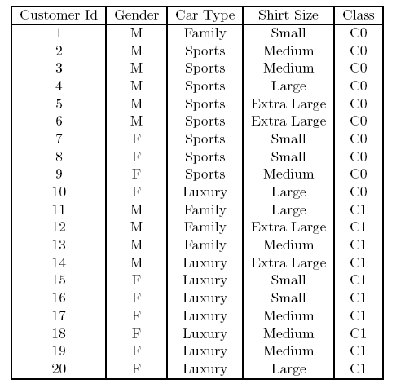
How to determine the Best Split
Before Splitting: 10 records of class 0, 10 records of class 1
Which test condition is the best?

Slide 62
How to determine the Best Split
Greedy approach:
Nodes with purer / homogeneous class distribution are preferred
Need a measure of node impurity:
High degree of impurity,
Non-homogeneous
Low degree of impurity,
Homogeneous

Slide 63
Measures of Node Impurity
Gini Index
Entropy
Misclassification Error
Where t is the dataset at node and J varies on the classes (es. pos, neg)
(NOTE: p( j | t) is the relative frequency of class j at node t).

Slide 64
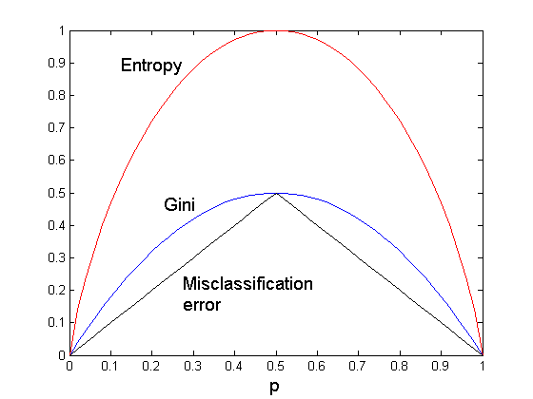
Comparison among Impurity Measures
For a 2-class problem:
Consistency among the impurity measures
if a node N1 has lower entropy than node N2, then the Gini index and error rate of N1 will also be lower than that of N2
The attribute chosen as splitting criterion by the impurity measures can still be different!
Notes:
Misclassification Error cresce e cala linearmente, Gini polinomiale quadratico, e Entropy esponenziale

Slide 65
Finding the Best Split
Compute impurity measure (P) before splitting
Compute impurity measure (M) after splitting
Compute impurity measure of each child node
M is the weighted impurity of children
Choose the attribute test condition that produces the highest gain (Gain = P-M) or equivalently, lowest impurity measure after splitting (M)

Slide 66
Finding the Best Split
Before Splitting:
P
A?
B?
Yes
No
Yes
No
Node N1
Node N2
Node N3
Node N4
M11
M12
M21
M22
M1
M2
Gain = P – M1 vs P – M2

Slide 67
Measure of Impurity: GINI
Gini Index for a given node t :
(NOTE: p( j | t) is the relative frequency of class j at node t).
Maximum (1 - 1/n_{c}) when records are equally distributed among all classes, implying least interesting information
Minimum (0.0) when all records belong to one class, implying most interesting information

Slide 68
Measure of Impurity: GINI
Gini Index for a given node t :
(NOTE: p( j | t) is the relative frequency of class j at node t).
For 2-class problem (p, 1 – p):
GINI = 1 – p² – (1 – p)² = 2p (1-p)

Slide 69
Computing Gini Index of a Single Node
P(C1) = 0/6 = 0 P(C2) = 6/6 = 1
Gini = 1 – P(C1)² – P(C2)² = 1 – 0 – 1 = 0
P(C1) = 1/6 P(C2) = 5/6
Gini = 1 – (1/6)² – (5/6)² = 0.278
P(C1) = 2/6 P(C2) = 4/6
Gini = 1 – (2/6)² – (4/6)² = 0.444

Slide 70
Gini Index for a Collection of Nodes
When a node p is split into k partitions (children)
where, n_{i} = number of records at child i,
n = number of records at parent node p.
Choose the split that minimizes weighted average Gini index of the children
Gini index is used in decision tree algorithms such as CART, SLIQ, SPRINT

Slide 71
Binary Attributes: Computing GINI Index
Splits into two partitions
Effect of Weighing partitions:
Larger and Purer Partitions are sought for.
B?
Yes
No
Node N1
Node N2
Gini(N1) = 1 – (5/6)² – (1/6)² = 0.278
Gini(N2) = 1 – (2/6)² – (4/6)² = 0.444
Weighted Gini of N1 N2 = 6/12 * 0.278 + 6/12 * 0.444 = 0.361
Gain = 0.486 – 0.361 = 0.125

Slide 72
Categorical Attributes: Computing Gini Index
For each distinct value, gather counts for each class in the dataset
Use the count matrix to make decisions
Multi-way split
Two-way split
(find best partition of values)
Which of these is the best?

Slide 73
Continuous Attributes: Computing Gini Index
Use Binary Decisions based on one value
Several Choices for the splitting value
Number of possible splitting values = Number of distinct values
Each splitting value has a count matrix associated with it
Class counts in each of the partitions, A < v and A >= v
Simple method to choose best v
For each v, scan the database to gather count matrix and compute its Gini index
Computationally Inefficient! (O(N2)) Repetition of work.
Annual Income ?
 | ≤ 80 | > 80
Defaulted Yes | 0 | 3
Defaulted No | 3 | 4

Slide 74
Continuous Attributes: Computing Gini Index...
For efficient computation O(N log N): for each attribute,
Sort the attribute on values
Linearly scan these values, each time updating the count matrix and computing gini index
Choose the split position that has the least Gini index
Sorted Values
Split Positions

Slide 75
Continuous Attributes: Computing Gini Index...
For efficient computation: for each attribute,
Sort the attribute on values
Linearly scan these values, each time updating the count matrix and computing gini index
Choose the split position that has the least Gini index
Sorted Values
Split Positions

Slide 76
Continuous Attributes: Computing Gini Index...
For efficient computation: for each attribute,
Sort the attribute on values
Linearly scan these values, each time updating the count matrix and computing gini index
Choose the split position that has the least Gini index
Sorted Values
Split Positions

Slide 77
Continuous Attributes: Computing Gini Index...
For efficient computation: for each attribute,
Sort the attribute on values
Linearly scan these values, each time updating the count matrix and computing gini index
Choose the split position that has the least Gini index
Sorted Values
Split Positions

Slide 78
Continuous Attributes: Computing Gini Index...
For efficient computation: for each attribute,
Sort the attribute on values
Linearly scan these values, each time updating the count matrix and computing gini index
Choose the split position that has the least Gini index
Sorted Values
Split Positions

Slide 79
Measure of Impurity: Entropy
Entropy at a given node t:
(NOTE: p( j | t) is the relative frequency of class j at node t).
Maximum (log n_{c}) when records are equally distributed among all classes implying least information
Minimum (0.0) when all records belong to one class, implying most information
Entropy based computations are quite similar to the GINI index computations

Slide 80
Computing Entropy of a Single Node
P(C1) = 0/6 = 0 P(C2) = 6/6 = 1
Entropy = – 0 log 0 – 1 log 1 = – 0 – 0 = 0
P(C1) = 1/6 P(C2) = 5/6
Entropy = – (1/6) log₂ (1/6) – (5/6) log₂ (5/6) = 0.65
P(C1) = 2/6 P(C2) = 4/6
Entropy = – (2/6) log₂ (2/6) – (4/6) log₂ (4/6) = 0.92

Slide 81
Computing Entropy of a Single Node
P(C1) = 3/6 = 0.5 P(C2) = 3/6 = 0.5
Entropy = – 0.5 log 0.5 – 0.5 log 0.5 = 0.5+0.5 = 1
Note: log 0.5 = log ½ = -1

Slide 82
Computing Information Gain After Splitting
Information Gain:
Parent Node, p is split into k partitions;
n_{i} is number of records in partition i
Measures Reduction in Entropy achieved because of the split. Choose the split that achieves most reduction (maximizes GAIN)
Used in the ID3 and C4.5 decision tree algorithms
Disadvantage: Tends to prefer splits that result in large number of partitions, each being small but pure.

Slide 83
Problem with large number of partitions
Node impurity measures tend to prefer splits that result in large number of partitions, each being small but pure
Customer ID has highest information gain because entropy for all the children is zero
Can we use such a test condition on new test instances?

Slide 84
Solution
A low impurity value alone is insufficient to find a good attribute test condition for a node
Solution: Consider the number of children produced by the splitting attribute in the identification of the best split
High number of child nodes implies more complexity
Method 1: Generate only binary decision trees
This strategy is employed by decision tree classifiers such as CART
Method 2: Modify the splitting criterion to take into account the number of partitions produced by the attribute

Slide 85
Gain Ratio
Gain Ratio:
Parent Node, p is split into k partitions
n_{i} is the number of records in partition i
Adjusts Information Gain by the entropy of the partitioning (SplitINFO).
Higher entropy partitioning (large number of small partitions) is penalized!
Used in C4.5 algorithm
Designed to overcome the disadvantage of Information Gain

Slide 86
Gain Ratio
Gain Ratio:
Parent Node, p is split into k partitions
n_{i} is the number of records in partition i
SplitINFO = 1.52
SplitINFO = 0.72
SplitINFO = 0.97

Slide 87
Measure of Impurity: Classification Error
Classification error at a node t :
Maximum (1 - 1/n_{c}) when records are equally distributed among all classes, implying least interesting information
Minimum (0) when all records belong to one class, implying most interesting information

Slide 88
Computing Error of a Single Node
P(C1) = 0/6 = 0 P(C2) = 6/6 = 1
Error = 1 – max (0, 1) = 1 – 1 = 0
P(C1) = 1/6 P(C2) = 5/6
Error = 1 – max (1/6, 5/6) = 1 – 5/6 = 1/6
P(C1) = 2/6 P(C2) = 4/6
Error = 1 – max (2/6, 4/6) = 1 – 4/6 = 1/3

Slide 89
Comparison among Impurity Measures
For a 2-class problem:
Consistency among the impurity measures
if a node N1 has lower entropy than node N2, then the Gini index and error rate of N1 will also be lower than that of N2
The attribute chosen as splitting criterion by the impurity measures can still be different!
Notes:
Misclassification Error cresce e cala linearmente, Gini polinomiale quadratico, e Entropy esponenziale

Slide 90
Misclassification Error vs Gini Index
A?
Yes
No
Node N1
Node N2
Gini(N1) = 1 – (3/3)² – (0/3)² = 0
Gini(N2) = 1 – (4/7)² – (3/7)² = 0.489
Gini(Children) = 3/10 * 0 + 7/10 * 0.489 = 0.342
Gini improves but error remains the same!!

Slide 91
Misclassification Error vs Gini Index
A?
Yes
No
Node N1
Node N2
Misclassification error for all three cases = 0.3 !

Slide 92
Stopping Criteria for Tree Induction
Stop expanding a node when all the records belong to the same class
Stop expanding a node when all the records have similar attribute values
Early termination (to be discussed later)

Slide 93
Algorithms: ID3, C4.5, C5.0, CART
ID3 uses the Hunt’s algorithm with information gain criterion and gain ratio
C4.5 improves ID3
Needs entire data to fit in memory
Handles missing attributes and continuous attributes
Performs tree post-pruning
C5.0 is the current commercial successor of C4.5
Unsuitable for Large Datasets
CART builds multivariate decision (binary) trees

Slide 94
Advantages of Decision Tree
Easy to interpret for small-sized trees
Accuracy is comparable to other classification techniques for many simple data sets
Robust to noise (especially when methods to avoid overfitting are employed)
Can easily handle redundant or irrelevant attributes
Inexpensive to construct
Extremely fast at classifying unknown record
Handle Missing Values

Slide 95
Decision Boundary
Border line between two neighboring regions of different classes is known as decision boundary
Decision boundary is parallel to axes because test condition involves a single attribute at-a-time

Slide 96
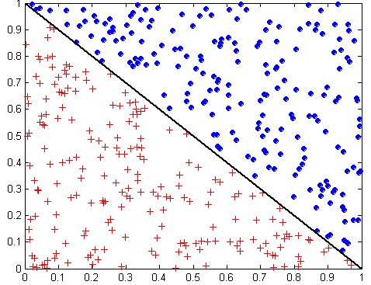
Oblique Decision Trees
x + y < 1
Class = +
Class =
Test condition may involve multiple attributes
More expressive representation
Finding optimal test condition is computationally expensive

Slide 97
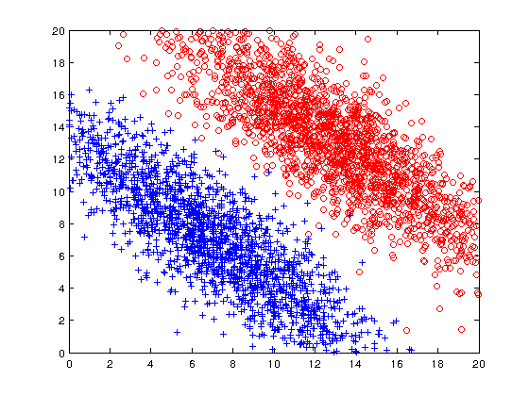
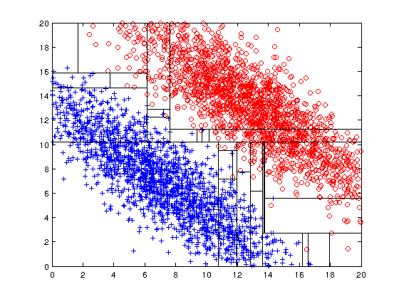
Limitations of single attribute-based decision boundaries
Both positive (+) and negative (o) classes generated from skewed Gaussians with centers at (8,8) and (12,12) respectively.
Test Condition
x + y < 20

Slide 98
Practical Issues of Classification
Underfitting and Overfitting
Costs of Classification
---- CONFUSION MATRIX -

Slide 99
Classification Errors
Training errors (apparent errors)
Errors committed on the training set
Test errors
Errors committed on the test set
Generalization errors
Expected error of a model over random selection of records from same distribution (of training or test set)

Slide 100
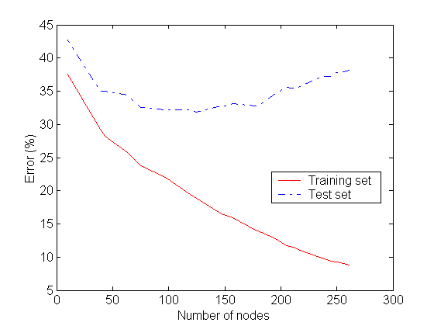
Underfitting and Overfitting
Overfitting
Underfitting: when model is too simple, both training and test errors are large

Slide 101
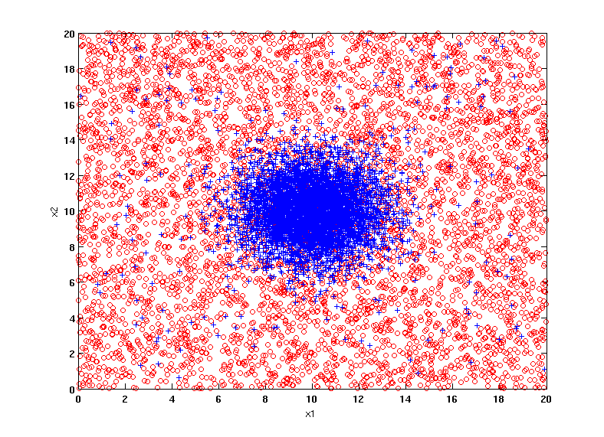
Example Data Set
Two class problem:
+ : 5200 instances
5000 instances generated from a Gaussian centered at (10,10)
200 noisy instances added
o : 5200 instances
Generated from a uniform distribution
10 % of the data used for training and 90% of the data used for testing

Slide 102
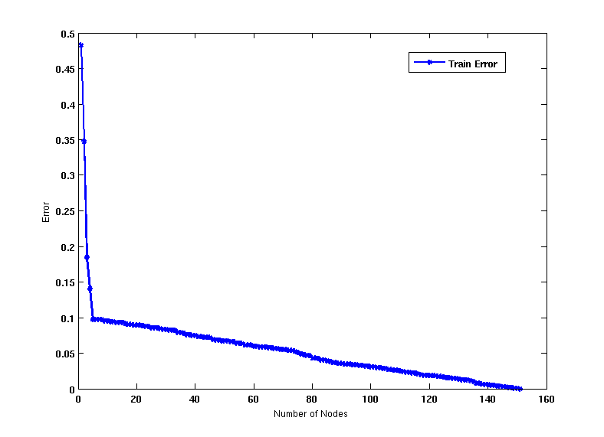
Increasing number of nodes in Decision Trees

Slide 103
Decision Tree with 4 nodes
Decision Tree
Decision boundaries on Training data

Slide 104
Decision Tree with 50 nodes
Decision Tree
Decision Tree
Decision boundaries on Training data

Slide 105
Which tree is better?
Decision Tree with 4 nodes
Which tree is better ?
Decision Tree with 50 nodes

Slide 106
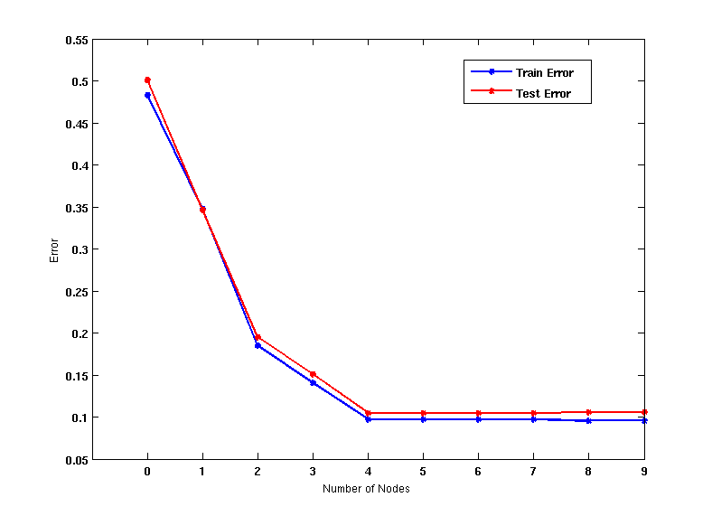
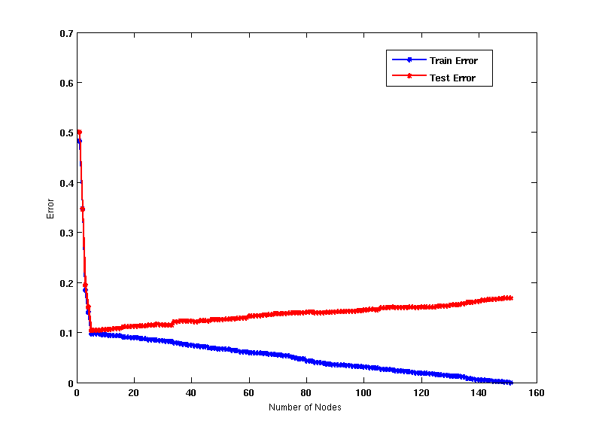
Model Overfitting
Underfitting: when model is too simple, both training and test errors are large
Overfitting: when model is too complex, training error is small but test error is large

Slide 107
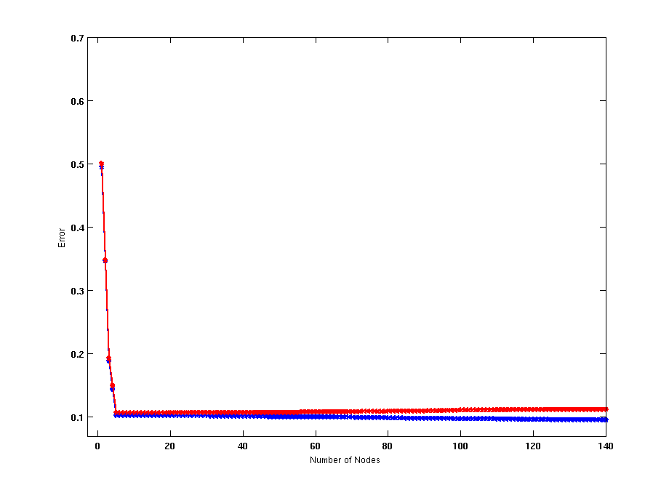
Model Overfitting
Using twice the number of data instances
If training data is under-representative, testing errors increase and training errors decrease on increasing number of nodes
Increasing the size of training data reduces the difference between training and testing errors at a given number of nodes

Slide 108
Model Overfitting
Decision Tree with 50 nodes
Decision Tree with 50 nodes
Using twice the number of data instances
If training data is under-representative, testing errors increase and training errors decrease on increasing number of nodes
Increasing the size of training data reduces the difference between training and testing errors at a given number of nodes

Slide 109
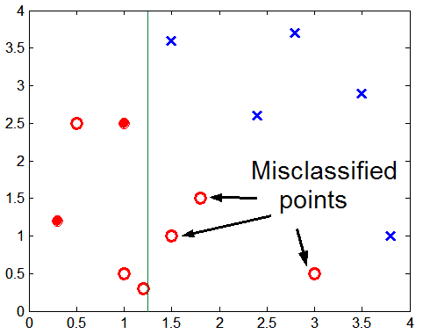
Overfitting due to Insufficient Examples
Lack of data points in the lower half of the diagram makes it difficult to predict correctly the class labels of that region
- Insufficient number of training records in the region causes the decision tree to predict the test examples using other training records that are irrelevant to the classification task

Slide 110
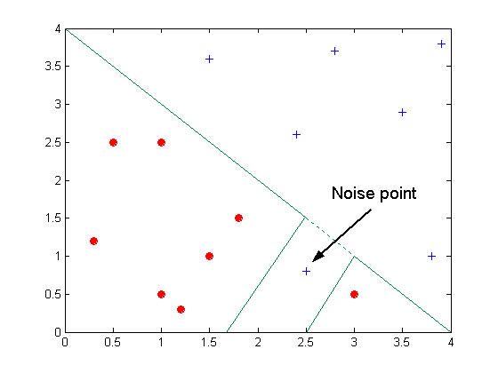
Overfitting due to Noise
Decision boundary is distorted by noise point

Slide 111
Notes on Overfitting
Overfitting results in decision trees that are more complex than necessary
Training error no longer provides a good estimate of how well the tree will perform on previously unseen records
Need new ways for estimating errors

Slide 112
Model Selection
Performed during model building
Purpose is to ensure that model is not overly complex (to avoid overfitting)
Need to estimate generalization error
Using Validation Set
Incorporating Model Complexity
Estimating Statistical Bounds

Slide 113
Model Selection Using Validation Set
Divide training data into two parts:
Training set:
use for model building
Validation set:
use for estimating generalization error
Note: validation set is not the same as test set
Drawback:
Less data available for training

Slide 114
Data Partitioning
Dataset
Train
Test
Holdout (e.g.70/30)
Train the model for final testing
Train
Validation
Test
Train the model for parameter selection
Validate the model (early stopping, parameter selection, etc.)
Test the model
Compare different models once parameters have been selected
Test
Cross Validation (check potential dataset bias)

Slide 115
Model Selection Incorporating Model Complexity
Rationale: Occam’s Razor
Given two models of similar generalization errors, one should prefer the simpler model over the more complex model
A complex model has a greater chance of being fitted accidentally by errors in data
Therefore, one should include model complexity when evaluating a model
Gen. Error(Model) = Train. Error(Model, Train. Data) +
x Complexity(Model)

Slide 116
Estimating Generalization Errors
Re-substitution errors: error on training (Σ err(t))
Generalization errors: error on testing (Σ err’(t))
Methods for estimating generalization errors:
Pessimistic approach
Optimistic approach
Reduced error pruning (REP):
uses validation data set to estimate generalization error

Slide 117
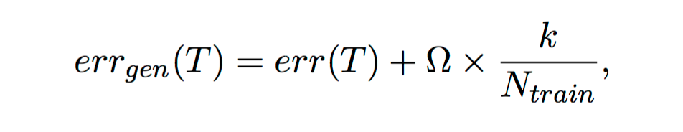
Estimating the Complexity of Decision Trees
Pessimistic Error Estimate of decision tree T with k leaf nodes:
err(T): error rate on all training records
Ω: Relative cost of adding a leaf node
k: number of leaf nodes
N_{train}: total number of training records

Slide 118
Estimating the Complexity of Decision Trees: Example
e(T_{L}) = 4/24
e(T_{R}) = 6/24
Ω = 1
e_{gen}(T_{L}) = 4/24 + 1*7/24 = 11/24 = 0.458
e_{gen}(T_{R}) = 6/24 + 1*4/24 = 10/24 = 0.417

Slide 119
Estimating the Complexity of Decision Trees
Re-substitution Estimate:
Using training error as an optimistic estimate of generalization error
Referred to as optimistic error estimate
e(T_{L}) = 4/24
e(T_{R}) = 6/24

Slide 120
Occam’s Razor
Given two models of similar generalization errors, one should prefer the simpler model over the more complex model
For complex models, there is a greater chance that it was fitted accidentally by errors in data
Therefore, one should include model complexity when evaluating a model

Slide 121
Minimum Description Length (MDL)
Cost(Model,Data) = Cost(Data|Model) + Cost(Model)
Cost is the number of bits needed for encoding.
Search for the least costly model.
Cost(Data|Model) encodes the misclassification errors.
Cost(Model) uses node encoding (number of children) plus splitting condition encoding.

Slide 122
Estimating Statistical Bounds
Apply a statistical correction to the training error rate of the model that is indicative of its model complexity.
Need probability distribution of training error: available or assumed.
The number of errors committed by a leaf node in a decision tree can be assumed to follow a binomial distribution.
Before splitting: e = 2/7, e’(7, 2/7, 0.25) = 0.503 e’(T) = 7 × 0.503 = 3.521
After splitting: e(T_{L}) = 1/4, e’(4, 1/4, 0.25) = 0.537 e(T_{R}) = 1/3, e’(3, 1/3, 0.25) = 0.650 e’(T) = 4 × 0.537 + 3 × 0.650 = 4.098
Therefore, do not split

Slide 123
How to Address Overfitting…
Pre-Pruning (Early Stopping Rule)
Stop the algorithm before it becomes a fully-grown tree
Typical stopping conditions for a node:
Stop if all instances belong to the same class
Stop if all the attribute values are the same
More restrictive conditions:
Stop if number of instances is less than some user-specified threshold
Stop if class distribution of instances are independent of the available features (e.g., using χ ² test)
Stop if expanding the current node does not improve impurity measures (e.g., Gini or information gain).
Stop if estimated generalization error falls below certain threshold

Slide 124
How to Address Overfitting…
Post-pruning
Grow decision tree to its entirety
Trim the nodes of the decision tree in a bottom-up fashion
If generalization error improves after trimming, replace sub-tree by a leaf node.
Class label of leaf node is determined from majority class of instances in the sub-tree
Can use MDL for post-pruning

Slide 125
Example of Post-Pruning
Class = Yes | 20
Class = No | 10
Error = 10/30
Training Error (Before splitting) = 10/30
Pessimistic error = (10 + 0.5)/30 = 10.5/30
Training Error (After splitting) = 9/30
Pessimistic error (After splitting)
= (9 + 4 × 0.5)/30 = 11/30
PRUNE!
Class = Yes | 8
Class = No | 4
Class = Yes | 3
Class = No | 4
Class = Yes | 4
Class = No | 1
Class = Yes | 5
Class = No | 1

Slide 126
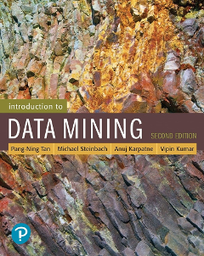
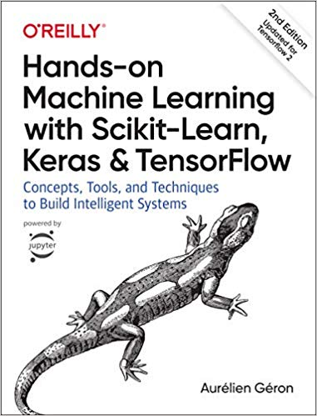
References
Chapter 7 “Introduction to Data Mining”,
Hands-on Machine Learning with Scikit-Learn, Keras & Tensorflow. A practical handbook to start wrestling with Machine Learning models (2nd ed).

Slide 127
Home work
Es1: Draw a decision tree for the problem of deciding whether to move forward at a road intersection, given that the light has just turned green.
Suppose we generate a training set from a decision tree and then apply decision-tree learning to that training set. Is it the case that the learning algorithm will eventually return the correct tree as the training-set size goes to infinity? Why or why not?
In the recursive construction of decision trees, it sometimes happens that a mixed set of positive and negative examples remains at a leaf node, even after all the attributes have been used. Suppose that we have positive examples and negative examples. 1. Show that the solution used by DECISION-TREE-LEARNING, which picks the majority classification, minimizes the absolute error over the set of examples at the leaf. 2. Show that the class probability minimizes the sum of squared errors.

Slide 128
Home work
1. In the recursive construction of decision trees, it sometimes happens that a mixed set of positive and negative examples remains at a leaf node, even after all the attributes have been used. Suppose that we have positive examples and negative examples. 1. Show that the solution which picks the majority classification, minimizes the absolute error over the set of examples at the leaf.
2. Show that the class probability minimizes the sum of squared errors.

Slide 129
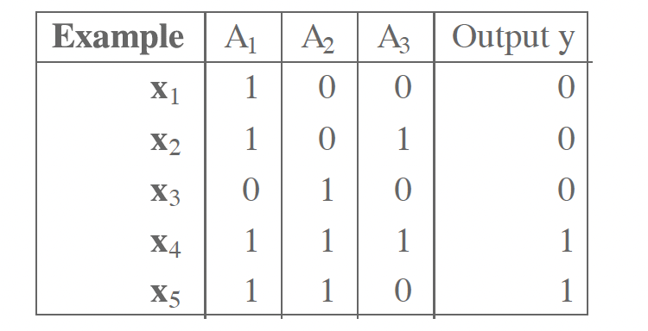
Home work
Consider the following data set comprised of three binary input attributes and one binary output.
Learn a decision tree for these data. Show the computations made to determine the attribute to split at each node.

Slide 130
References
Chapter 3. Classification: Basic Concepts and Techniques.

